Slide 1
UNIT IV
Regular Expressions and GUI Programming

Slide 2
Concept of Regular Expression
The regular expressions can be defined as the sequence of characters which are used to search for a pattern in a string.
The module re provides the support to use regex in the python program.
The re module must be imported to use the regex functionalities in python:
import re

Slide 3
Forming a regular expression
A regular expression can be formed by using the mix of meta-characters,special sequences and sets.

Slide 4
Regex Functions
Function | Description
match | This method matches the regex pattern in the string with the optional flag. It returns true if a match is found in the string otherwise it returns false.
search | This method returns the match object if there is a match found in the string.
findall | It returns a list that contains all the matches of a pattern in the string.
split | Returns a list in which the string has been split in each match.
sub | Replace one or many matches in the string.

Slide 5
Meta-Characters
Metacharacter is a character with the specified meaning.

Slide 6
Metacharacters and Description
Metacharacter | Description | Example
[] | It represents the set of characters. | "[a-z]"
\ | It represents the special sequence. | "\r"
. | It signals that any character is present at some specific place. | "Ja.v."
^ | It represents the pattern present at the beginning of the string. | "^Java"
$ | It represents the pattern present at the end of the string. | "point"
* | It represents zero or more occurrences of a pattern in the string. | "hello*"
+ | It represents one or more occurrences of a pattern in the string. | "hello+"
{} | The specified number of occurrences of a pattern the string. | "java{2}"
| | It represents either this or that character is present. | "java|point"
() | Capture and group

Slide 7
The findall() function
import re
str = "How are you. How is everything"
matches = re.findall("How", str)
print(matches)
Output
['How', 'How']

Slide 8
The match object
import re
str = "How are you. How is everything"
matches = re.search("How", str)
print(type(matches))
print(matches) #matches is the search object
Output
<class '_sre.SRE_Match'>
<_sre.SRE_Match object; span=(0, 3), match='How'>

Slide 9
The search( ) function
import re
txt = “The rain in Spain”
x = re.search(“\s”, txt)
print(“The first white-space character at:”,x.start( ))
Output
The first white-space character at:3

Slide 10
The sub( ) function
import re
txt = “The rain in Spain”
x = re.sub(“\s”, “9”, txt)
print(x)
OUTPUT
The9rain9in9Spain

Slide 11
The split( ) function
import re
txt = “The rain in Spain”
x = re.split(“\s”, txt)
print(x)
OUTPUT
[‘The’, ‘rain’, ‘in’, ‘Spain’]

Slide 12
GUI Programming in Python
GUI stands for Graphical User Interface.
A GUI allows a user to interact with a computer program using a pointing device that manipulates small pictures on a computer screen.
The small pictures are called icons or widgets.
The programs that use a graphical user interface are called as “GUI programs”.

Slide 13
Introduction to Tkinter
Tkinter is the Python interface to the Tk GUI toolkit.
It is developed by John
Tkinter is included with standard Linux,Microsoft Windows and Mac OS X installs of Python.
Tkinter is free software released under a Python license.
Tkinter provides a powerful object-oriented interface to the Tk GUI toolkit.

Slide 14
Creating a GUI application using Tkinter is an easy task.
The steps are:
Import the Tkinter module.
Create the GUI application main window.
Add one or more of widgets to the GUI application.
Enter the main event loop to take action against each event triggered by the user.

Slide 15
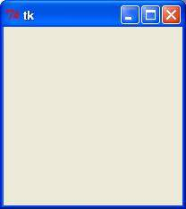
Example
#!/usr/bin/python
import tkinter
top = tkinter.Tk()
# Code to add widgets will go here...
top.mainloop()

Slide 16
Tkinter Widgets
Button –The Button widget is used to display in
application.
Canvas – The Canvas widget is used to draw shapes, such
as lines, ovals in application.
Checkbutton –The Checkbutton widget is used to display a
number of options as checkboxes. The user can
select multiple options at a time.
Entry – The Entry widget is used to display a single-line text field
for accepting values from a user.
Frame – The Frame widget is used as a container widget to organize
other widgets.

Slide 17
Label – The Label widget is used to provide a
single-line caption for other widgets.
It can also contain images.
Listbox – The Listbox widget is used to
provide a list of options to a user.
Menubutton – The Menubutton widget is used
to display menus in application.
Menu – The Menu widget is used to provide
various commands to a user.
Text – The Text widget is used to display text in
multiple lines.

Slide 18
Layout management with pack,grid and place
All Tkinter widgets have access to specific layout management methods which organize widgets throughout the parent widget area.
Tkinter includes layout manager classes: pack,grid and place.

Slide 19
The pack() Method
This layout manager organizes widgets in blocks before placing them in the parent widget.

Slide 20
The grid() Method
This layout manager organizes widgets in a table-like structure in the parent widget.

Slide 21
The place() Method
This layout manager organizes widgets by placing them in a specific position in the parent widget.

Slide 22

Create a label widget
from tkinter import *
window = Tk()
window.title(“Welcome”)
lbl = Label(window,text =“Hello”)
lbl.grid(column=0,row=0)
window.mainloop()

Slide 23
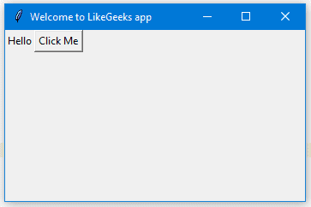
Adding a button widget
from tkinter import *
window = Tk()
window.title(“Welcome to LikeGeeks app”)
window.geometry(‘350x200’)
lbl = Label(window,text =“Hello”)
lbl.grid(column=0,row=0)
btn = Button(window, text = “Click Me”)
btn.grid(column=1,row=0)
window.mainloop()

Slide 24
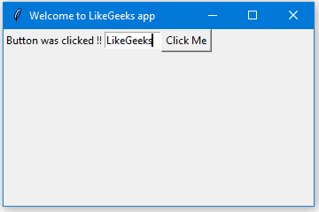
Tkinter textbox
from tkinter import *
window = Tk()
window.title(“Welcome to LikeGeeks app”)
window.geometry(‘350x200’)
lbl = Label(window,text =“Hello”)
lbl.grid(column=0,row=0)
txt = Entry(window,width=10)
txt.grid(column=1,row=0)
def clicked():
lbl.configure(text=“Button was clicked”)
btn = Button(window,text=“Click me”,command=clicked)
btn.grid(column=2,row=0)
window.mainloop()

Slide 25
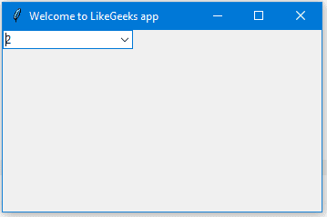
Add a combobox widget
from tkinter import *
from tkinter.ttk import *
window = Tk()
window.title(“Welcome to LikeGeeks app”)
window.geometry(‘350x200’)
Combo = Combobox(window)
Combo[‘values’] = (1,2,3,4,5, “Text”)
Combo.current(1) #set the selected item
Combo.grid(column=0,row=0)
window.mainloop()

Slide 26
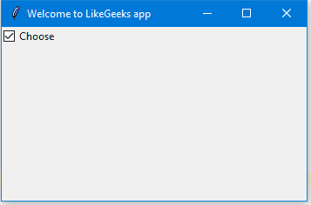
Add a Checkbutton widget (Tkinter checkbox)
from tkinter import *
from tkinter.ttk import *
window = Tk()
window.title(“Welcome to LikeGeeks app”)
window.geometry(‘350x200’)
chk_state = BooleanVar()
chk_state.set(True) #set check state
chk = Checkbutton(window,text=‘Choose’,var=chk_state)
chk.grid(column=0, row=0)
window.mainloop()

Slide 27
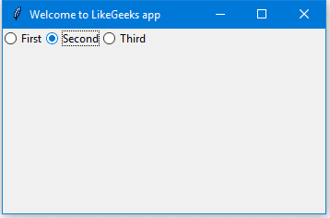
Add radio buttons widgets
from tkinter import *
from tkinter.ttk import *
window = Tk()
window.title(“Welcome to LikeGeeks app”)
window.geometry(‘350x200’)
rad1 = Radiobutton(window,text=‘First’,value=1)
rad2 = Radiobutton(window,text=‘Second’,value=2)
rad3 = Radiobutton(window,text=‘Third’,value=3)
rad1.grid(column=0,row=0)
rad2.grid(column=1,row=0)
rad3.grid(column=2,row=0)
window.mainloop()

Slide 28
GUI Programming with Tkinter layout managers:
pack,grid,place

Slide 29

pack layout manager
import tkinter as tk
root = tk.Tk()
w = tk.Label(root,text=“Red Sun”, bg = “red”, fg = “white”)
w.pack()
w = tk.Label(root,text=“Green Grass”, bg = “green”, fg = “black”)
w.pack()
w = tk.Label(root,text=“Blue Sky”, bg = “blue”, fg = “white”)
w.pack()
tk.mainloop()
OUTPUT

Slide 30
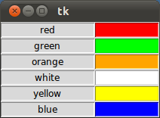
grid layout manager
import tkinter as tk
colours = [‘red’,’green’,’orange’,’white’,’yellow’,’blue’]
r=0
for c in colours:
tk.Label(text=c,relief=tk.RIDGE, width=15).grid(row=r,column=0)
tk.Entry(bg=c, relief=tk.SUNKEN,width=10).grid(row=r,column=1)
r=r+1
tk.mainloop()

Slide 31
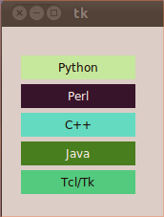
place layout manager
import tkinter as tk
import random
root = tk.Tk()
# width x height + x_offset + y_offset:
root.geometry("170x200+30+30")
languages = ['Python','Perl','C++','Java','Tcl/Tk']
labels = range(5)
for i in range(5):
ct = [random.randrange(256) for x in range(3)]
brightness = int(round(0.299*ct[0] + 0.587*ct[1] + 0.114*ct[2]))
ct_hex = "%02x%02x%02x" % tuple(ct)
bg_colour = '#' + "".join(ct_hex)
l = tk.Label(root, text=languages[i], fg='White' if brightness < 120 else 'Black', bg=bg_colour)
l.place(x = 20, y = 30 + i*30, width=120, height=25)
root.mainloop()
OUTPUT

Slide 32
Widgets with attributes:Frame,Label,Button

Slide 33
Frame
The Frame widget is used for grouping and organizing other widgets.
It works like a container,which is responsible for arranging the position of other widgets
It uses rectangular areas in the screen to organize the layout and to provide padding of these widgets.
A frame can also be used as a foundation class to implement complex widgets

Slide 34
Syntax:
w = Frame(master, option,…….)
Parameters
master – This represents the parent
window.
options – It is the list of most commonly
used options for this widget.
These options can be used as
key-value pairs separated by
commas.

Slide 35
Option | Description
bg | The normal background color displayed behind the label and indicator.
bd | The size of the border around the indicator. Default is 2 pixels.
cursor | If this option is set to a cursor name(arrow,dot etc.), the mouse cursor will change to that pattern when it is over the checkbutton.
height | The vertical dimension of the new frame.
highlightbackground | Color of the focus highlight when the frame does not have focus.
highlightcolor | Color shown in the focus highlight when the frame has the focus
highlightthickness | Thickness of the focus highlight.
relief | The default value is relief=FLAT. With this value, the checkbutton does not stand out from its background.
width | Default width of checkbutton is determined by size of displayed image or text. Set this option to a number of characters.

Slide 36

Example
from tkinter import *
root = Tk()
frame = Frame(root)
frame.pack()
bottomframe = Frame(root)
bottomframe.pack(side = BOTTOM)
redbutton = Button(frame, text = “Red”, fg=“red”)
redbutton.pack(side=LEFT)
greenbutton = Button(frame, text = “Brown”, fg=“brown”)
greenbutton.pack(side=LEFT)
bluebutton = Button(frame, text = “Blue”, fg=“blue”)
bluebutton.pack(side=LEFT)
blackbutton = Button(frame, text = “Black”, fg=“black”)
blackbutton.pack(side=BOTTOM)
root.mainloop()

Slide 37
Label
This widget implements a display box where we can place text or images.
The text displayed by this widget can be updated at any time.
It is also possible to underline part of the text and span the text across multiple lines.

Slide 38
Syntax
w = Label(master,option,…)
Parameters
master – This represents the parent window.
options – Here is the list of most commonly used options for this widget. These options can be used as key-value pairs separated by commas.

Slide 39
Option | Description
anchor | This options controls where the text is positioned if the widget has more space than the text needs. The default is anchor=CENTER, which centers the text in the available space.
bg | The normal background color displayed behind the label and indicator.
bitmap | Set this option equal to a bitmap or image object and the label will display that graphic.
bd | The size of the border around the indicator. Default is 2 pixels.
cursor | If this option is set to a cursor name(arrow,dot etc.), the mouse cursor will change to that pattern when it is over the checkbutton.
font | If text is displayed in this label, the font option specifies in what font that text will be displayed.
fg | If text is displayed or a bitmap in this label, this option specifies the color of the text.
height | The vertical dimension of the new frame.
image | To display a static image the label widget, set this option to an image object.

Slide 40
Option | Description
justify | Specifies how multiple lines of text will be aligned with respect to each other.
padx | Extra space added to the left and right of the text within the widget. Default is 1.
pady | Extra space added above and below the text within the widget. Default is 1.
relief | Specifies the appearance of a decorative border around the label. The default is FLAT.
text | To display one or more lines of text in a label widget, set this option to a string containing the text.
textvariable | To slave the text displayed in a label widget to a control variable of class StringVar, set this option to that variable.
underline | Display an underline(_) below the nth letter of the text, counting from 0, by setting this option to n. The default is underline=-1, which means no underlining.
width | Width of the label in characters.
wraplength | Limit the number of characters in each line by setting this option to the desired number.

Slide 41

Example
from Tkinter import *
root = Tk()
var = StringVar()
label = Label(root, textvariable=var, relief=RAISED)
var.set(“Hey!? How are you doing?”)
label.pack()
root.mainloop()
OUTPUT

Slide 42
Button
The Button widget is used to add buttons in a Python application.
These buttons can display text or images that convey the purpose of the buttons.
A function or a method can be attached to a button which is called automatically when a button is clicked.

Slide 43
Syntax
w = Button(master,option=value)
Parameters
master – This represents the parent window.
options – Here is the list of most commonly used options for this widget. These options can be used as key-value pairs separated by commas.

Slide 44
Option | Description
activebackground | Background color when the button is under the cursor
activeforeground | Foreground color when the button is under the cursor
bd | Border width in pixels. Default is 2.
bg | Normal background color.
command | Function or method to be called when the button is clicked.
fg | Normal foreground (text) color.
font | Text font to be used for the button’s label.
height | Height of the button in text lines (for textual buttons) or pixels(for images)
highlightcolor | The color of the focus highlight when the widget has focus.

Slide 45
Option | Description
image | Image to be displayed on the button
justify | Show multiple text lines:LEFT to left-justify each line, CENTER to center them, RIGHT to right-justify
padx | Additional padding left and right of the text.
pady | Additional padding above and below the text.
relief | Relief specifies the type of the border. Some of the values are SUNKEN,RAISED,GROOVE and RIDGE.
state | Set this option to DISABLED to gray out the button and make it unresponsive. Has the value ACTIVE when the mouse is over it.Default is NORMAL.
underline | Default is -1 which means that no character of the text on the button will be underlined.If nonnegative, the corresponding text character will be underlined.
width | Width of the button in letters(text) or pixels(image)
wraplength | If this value is set to a positive number, the text lines will be wrapped to fit within this length.

Slide 46
Method | Description
flash() | Causes the button to flash several times between active and normal colors.Leaves the button in the state it was in originally. Ignored if the button is disabled.
invoke() | Calls the button’s callback, and returns what that function returns. Has no effect if the button is disabled or there is no callback.

Slide 47
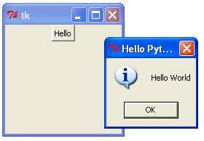
Example
import tkinter
from tkinter import messagebox
top = tkinter.Tk()
def helloCallBack:
messagebox.showinfo(“Hello Python”, “Hello World”)
B = tkinter.Button(top,text=“Hello”,command=helloCallBack)
B.pack()
top.mainloop()

Slide 48
Checkbutton
The Checkbutton widget is a standard widget that is used to implement on/off selections.
Checkbuttons can contain text or images.
When the button is pressed, Tkinter calls that function or method.

Slide 49
Syntax
w = Checkbutton(master,options)
Parameters
master – This parameter is used to represent the parent window.
options – There are many options which are available and they are used as key-value pairs separated by commas.

Slide 50
Options | Description
activebackground | Represent background color when checkbutton is under cursor
activeforeground | Represent foreground color when checkbutton is under cursor
bg | Represent normal background color displayed behind label and indicator
bitmap | Display monochrome image on button
bd | Represent size of border around indicator .Default value is 2 pixels.
command | Associated with a function to be called when state of checkbutton is changed
cursor | Mouse cursor will change to that pattern when it is over checkbutton
disabledforeground | Foreground color used to render text of disabled checkbutton.
font | Represent font for text
fg | Represent color used to render text
height | Represent number of lines of text on checkbutton.Default value is 1.
highlightcolor | Represent color of focus highlight when checkbutton has focus.
image | Display graphic image on button

Slide 51
Options | Description
justify | Control how text is justified
offvalue | Change state of an unchecked variable to some other one
onvalue | Change state of checked variable to some other one
padx | Represent space to leave to left and right of checkbutton
pady | Represent space to leave above and below checkbutton
relief | Type of border of checkbutton. Default is FLAT.
selectcolor | Represent color of checkbutton when it is set
selectimage | Image shown on checkbutton when it is set
state | Represents state of checkbutton
text | Use newlines(“\n”) to display multiple lines of text
underline | Represent index of character in text which is to be underlined
variable | Used to represent associated variable to track state of checkbutton
width | Used to represent width of checkbutton
wraplength | Breaks text into number of pieces

Slide 52
Methods:
deselect() : Calls to turn off checkbutton
flash() : Checkbutton is flashed between
active and normal colors
invoke() : Invokes method associated with
checkbutton
select() : Called to turn on checkbutton
toggle() :Used to toggle between different
Checkbuttons

Slide 53
Example
from tkinter import *
root = Tk()
root.geometry(“300x200”)
w = Label(root, text = ‘GeeksForGeeks’ font = “50”)
w.pack()
Checkbutton1 = IntVar()
Checkbutton2 = IntVar()
Checkbutton3 = IntVar()

Slide 54
Button1 = Checkbutton(root, text = “Tutorial”, variable = Checkbutton1,onvalue = 1,offvalue = 0,height = 2, width = 10)
Button2 = Checkbutton(root, text = “Student”, variable = Checkbutton2,onvalue = 1,offvalue = 0,height = 2, width = 10)
Button3 = Checkbutton(root, text = “Courses”, variable = Checkbutton3,onvalue = 1,offvalue = 0,height = 2, width = 10)
Button1.pack()
Button2.pack()
Button3.pack()
mainloop()

Slide 55
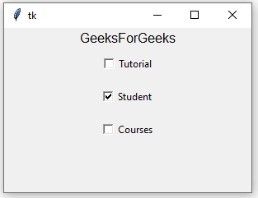
Output

Slide 56
Radio button
It is a standard Tkinter widget used to implement one-of-many selections.
Radiobuttons can contain text or images.
We can associate a Python function or method with each button.
When the button is pressed,Tkinter automatically calls that function or method.

Slide 57
Syntax
button = Radiobutton(master,text=“Name on Button”,variable = “shared variable”, value = “values of each button”, options = values,…)
shared variable = A Tkinter variable shared among all Radio buttons
value = Each radiobutton should have different value otherwise more than 1 radiobutton will get selected.

Slide 58
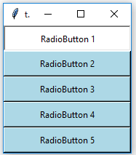
from tkinter import *
master = Tk()
master.geometry(“175X175”)
v = StringVar(master, “1”)
values = { “RadioButton 1” : “1”,
“RadioButton 2” : “2”,
“RadioButton 3” : “3”,
“RadioButton 4” : “4”,
“RadioButton 5” : “5”}
for(text,value) in values.items():
Radiobutton(master, text = text, variable = v, value = value,indicator = 0, background = “light blue”).pack(fill = X,ipady = 5)
mainloop()
OUTPUT

Slide 59
Entry widget
The Entry widget is a Tkinter widget used to enter or display a single line of text.
Syntax
entry = tk.Entry(parent,options)
Parameters
parent – The Parent window or frame in which the widget to display.
Options – There are various options provided by the entry widget.

Slide 60
Options | Description
bg | The normal background color displayed behind the label and indicator.
bd | The size of the border around the indicator. Default is 2 pixels.
font | The font used for the text.
fg | The color used to render the text.
justify | If the text contains multiple lines, this option controls how text is justified: CENTER, LEFT or RIGHT
relief | With the default value, relief=FLAT, set this option to any of the other styles like: SUNKEN, RIGID, RAISED, GROOVE.
show | Normally, the characters that the user types appear in the entry. To make a password entry that echoes each character as an asterisk, set show = “*”.
textvariable | To retrieve current text from entry widget, set this option to an instance of StringVar class.

Slide 61
Methods:
get() : Returns the entry’s current text as a string.
delete() : Deletes characters from the widget.
insert(index, ‘name’) : Inserts string ‘name’ before the character at the given index.

Slide 62
Example(Simple login screen)
import tkinter as tk
root=tk.Tk()
root.geometry("600x400")
name_var=tk.StringVar()
passw_var=tk.StringVar()
def submit():
name=name_entry.get()
password=passw_var.get()
print("The name is : " + name)
print("The password is : " + password)
name_var.set("")
passw_var.set("")

Slide 63
Contd…
name_label = tk.Label(root, text = 'Username',
font=('calibre',10, 'bold'))
name_entry = tk.Entry(root, textvariable = name_var,font=('calibre',10,'normal'))
passw_label = tk.Label(root, text = 'Password',
font = ('calibre',10,'bold'))
passw_entry=tk.Entry(root, textvariable = passw_var, font = ('calibre',10,'normal'),
show = '*')

Slide 64
Contd…
sub_btn=tk.Button(root,text = 'Submit', command = submit)
name_label.grid(row=0,column=0)
name_entry.grid(row=0,column=1)
passw_label.grid(row=1,column=0)
passw_entry.grid(row=1,column=1)
sub_btn.grid(row=2,column=1)
root.mainloop()

Slide 65
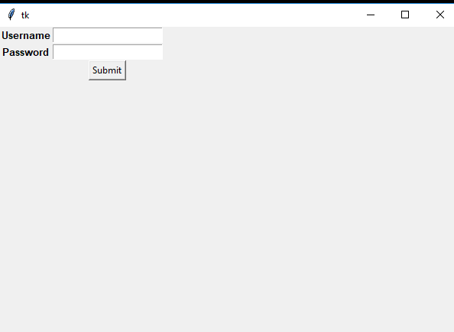
OUTPUT

Slide 66
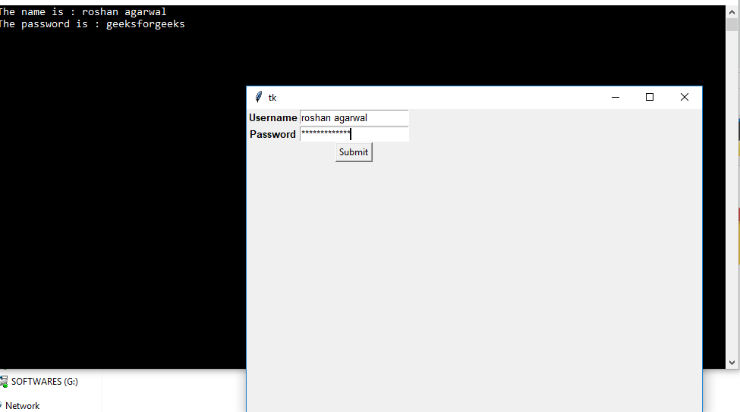

Slide 67
Listbox
The Listbox widget is used to display a list of items from which a user can select a number of items.
Syntax
w = Listbox(master,option,…)
Parameters
master- This represents the parent window.
options – It contains list of most commonly used options for this widget.

Slide 68
Options | Description
bg | The normal background color displayed behind the label and indicator
bd | The size of the border around the indicator. Default is 2 pixels.
cursor | The cursor that appears when the mouse is over the listbox.
font | The font used for the text in the listbox.
fg | The color used for the text in the listbox.
height | Number of lines shown in the listbox.

Slide 69
Option | Description
highlightcolor | Color shown in the focus highlight when the widget has the focus
highlightthickness | Thickness of the focus highlight
relief | Selects three-dimensional border shading effects. The default is SUNKEN.
selectbackground | The background color to use displaying selected text.
selectmode | Determines how many items can be selected and how mouse drags affect the selection
width | The width of the widget in characters. The default is 20
xscrollcommand | If user is allowed to scroll the listbox horizontally, link listbox widget to a horizontal scrollbar
yscrollcommand | If user is allowed to scroll the listbox vertically, link listbox widget to a vertical scrollbar

Slide 70
Methods
activate(index) – Selects the line specified by the given index.
curselection() – Returns a tuple containing line numbers of selected elementor elements counting from 0
delete(first,last=None) –Deletes lines whose indices are in range[first,last].
get(first,last=None) – Returns a tuple containing text of lines with indices from first to last, inclusive.

Slide 71
index(i) –If possible, positions the visible part of the listbox so that line containing index i is at the top of the widget.
insert(index,*elements) – Insert one or more new lines into the listbox before the line specified by index.
nearest(y)- Return the index of the visible line closest to the y-coordinate y relative to the listbox widget.
see(index) – Adjust the position of the listbox so that the line referred to by index is visible.

Slide 72
size()- Returns the number of lines in the listbox
xview() – To make the listbox horizontally scrollable,set the command option of the associated horizontal scrollbar to this method.
yview() - To make the listbox vertically scrollable,set the command option of the associated vertical scrollbar to this method.

Slide 73
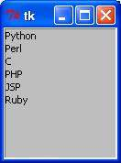
Example
from tkinter import *
import tkMessageBox
import tkinter
top =Tk()
Lb1 = Listbox(top)
Lb1.insert(1, “Python”)
Lb1.insert(2, “Perl”)
Lb1.insert(3, “C”)
Lb1.insert(4, “PHP”)
Lb1.insert(5, “JSP”)
Lb1.insert(6, “Ruby”)
Lb1.pack()
top.mainloop()

Slide 74
Text Widget
Text Widget is used where a user wants to insert multiline text fields.
This widget can be used for a variety of applications where the multiline text is required such as messaging, sending information or displaying information.
We can insert media files such as images and links in Text widget.

Slide 75
Syntax:
T = Text(root,bg,fg,bd,height,width,font,..)

Slide 76
Optional Parameters of Text Widget
Parameters | Description
root | root window
bg | background colour
fg | foreground colour
bd | border of widget
height | height of the widget
width | width of the widget
font | Font type of the text
cursor | The type of the cursor to be used
insertofftime | The time in milliseconds for which the cursor blink is off

Slide 77
Contd…
Parameters | Description
insertontime | the time in milliseconds for which the cursor blink is on
padx | horizontal padding
pady | vertical padding
state | defines if the widget will be responsive to mouse or keyboards movements
highlightthickness | defines the thickness of the focus highlight
insertionwidth | defines the width of insertion character
relief | type of the border which can be SUNKEN,RAISED,GROOVE and RIDGE
yscrollcommand | to make the widget vertically scrollable
xscrollcommand | to make the widget horizontally scrollable

Slide 78
Common methods
Method | Description
index(index) | To get the specified index
insert(index) | To insert a string at a specified index
see(index) | Checks if a string is visible or not at a given index
get(startindex,endindex) | to get characters within a given range
delete(startindex,endindex) | deletes characters within specified range

Slide 79
Tag handling methods The tags are the names given to the separate areas of the text. The tags are used to configure the different areas of the text separately.
Method | Description
tag_delete(tagname) | To delete a given tag
tag_add(tagname,startindex,endindex) | to tag the string in the specified range
tag_remove(tagname,startindex,endindex) | to remove a tag from specified range

Slide 80
Mark handling methods Marks are used to bookmark the specified position between the characters of the associated text.
Method | Description
mark_names() | to get all the marks in the given range
index(mark) | to get index of a mark
mark_gravity() | to get the gravity of a given mark

Slide 81
Example
import tkinter as tk
root = tk.Tk()
root.geometry(“250x170”)
T=tk.Text(root,height=5,width=52)
l = tk.Label(root,text=“Fact of the Day”)
l.config(font=(“Courier”,14))
Fact = “ “ “A man can be arrested in
Italy for wearing a skirt in public.” ” ”
b1 = tk.Button(root,text=“Next”)
b2=tk.Button(root,text=“Exit”,command=root.destroy)
l.pack()
T.pack()
b1.pack()
b2.pack()
T.insert(tk.END,Fact)
tk.mainloop()

Slide 82
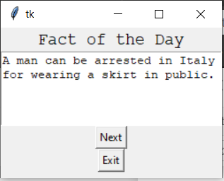
Output

Slide 83
Events and Bindings
Event refers to occurrence of an activity.
Events can be key presses or mouse operations by the user.
Tkinter provides a mechanism to deal with events.
For each widget, it is possible to bind Python functions and methods to an event.
If the defined event occurs in the widget, the “handler” function is called with an event object describing the event.

Slide 84
Tkinter uses event-sequences for allowing the user to define the events to bind to handlers.
It is the first argument “event” of the bind method.
The event sequence is given as a string, using the following syntax:
<modifier-type-detail>
The type field is the essential part of an event specifier.
The “modifier” and “detail” fields are used to provide additional information for the chosen “type”.
The event “type” describes the kind of event to be bound.
For example, actions like mouse clicks, key presses or the widget got the input focus.

Slide 85
Event | Description
<Button> | A mouse button is pressed with the mouse pointer over the widget. The detail part specifies which button. e.g. The left mouse button is defined by the event <Button-1>, the middle button by <Button-2>, the rightmost mouse button by <Button-3>. <Button-4> defines the scroll up event on mice with wheel support and <Button-5> the scroll down.
<Motion> | The mouse is moved with a mouse button being held down. To specify the left,middle or right mouse button use <B1-Motion>,<B2-Motion> and <B3-Motion>. The current position of the mouse pointer is provided in x and y members of event object passed to callback which is event.x , event.y
<ButtonRelease> | Occurs an event if a button is released. To specify the left,middle or right mouse button use <ButtonRelease-1>,<ButtonRelease-2> and <ButtonRelease-3>. The current position of the mouse pointer is provided in x and y members of event object passed to callback which is event.x , event.y

Slide 86
Event | Description
<Double-Button> | The button is double clicked. To specify left, middle or right mouse button use <Double-Button-1>,<Double-Button-2>,<Double-Button-3>.
<Enter> | The mouse pointer entered widget.
<Leave> | The mouse pointer left the widget.

Slide 87
Event | Description
<FocusIn> | Keyboard focus was moved to this widget or, to a child of this widget.
<FocusOut> | Keyboard focus was moved from this widget to another widget.
<Return> | The user pressed the Enter key.
<Key> | The user pressed any key. The key is provided in the char member of the event object passed to the callback
a | The user typed an “a” key. Most printable characters can be used as it is. The exceptions are space (<space>) and less than (<less>)

Slide 88
Event | Description
<Shift-Up> | The user pressed the Up arrow, while holding the Shift key pressed. We can use prefixes like Alt, Shift and Control.
<Configure> | The size of the widget is changed. The new size is provided in the width and height attributes of the event object passed to the callback.

Slide 89
Binding function in Tkinter
The binding function is used to deal with the events.
We can bind Python’s functions and methods to an event and we can bind these functions to any particular widget.

Slide 90
Binding mouse movement with Tkinter Frame
# Import all files from
# tkinter and overwrite
# all the tkinter files
# by tkinter.ttk
from tkinter import *
from tkinter.ttk import *
# creates tkinter window or root window
root=Tk()
root.geometry(‘200X100’)
# function to be called when mouse enters in a frame
def enter(event):
print(‘Button-2 pressed at x=%d, y=%d’%(event.x,event.y))
# function to be called when mouse exits the frame
def exit_(event):
print(‘Button-3 pressed at x=%d,y=%d’%(event.x,event.y))
# frame with fixed geometry
frame1=Frame(root,height=100,width=200)
# these lines are showing the
# working of bind function
# it is universal widget method
frame1.bind(‘<Enter>’,enter)
frame1.bind(‘<Leave>’,exit_)
frame1.pack()
mainloop()

Slide 91
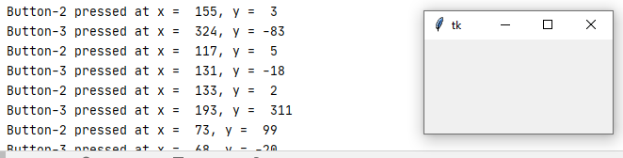
Output

Slide 92
Binding Mouse buttons with Tkinter Frame
# Import all files from
# tkinter and overwrite
# all the tkinter files
# by tkinter.ttk
from tkinter import *
from tkinter.ttk import *
# creates tkinter window or root window
root=Tk()
root.geometry(‘200X100’)
# function to be called when button-2 of mouse is pressed
def pressed2(event):
print(‘Button-2 pressed at x=%d,y=%d’%(event.x,event.y))
# function to be called when button-3 of mouse is pressed
def pressed3(event):
print(‘Button-3 pressed at x=%d,y=%d’%(event.x,event.y))
## function to be called when button-1 is double clicked
def double_click(event):
print(‘Double clicked at x=%d,y=%d’%(event.x,event.y))
frame1=Frame(root,height=100,width=200)
# these lines are binding mouse
# buttons with the Frame widget
frame1.bind(‘<Button-2>’,pressed2)
frame1.bind(‘<Button-3>’,pressed3)
frame1.bind(‘<Double 1>’,double_click)
frame1.pack()
mainloop()

Slide 93
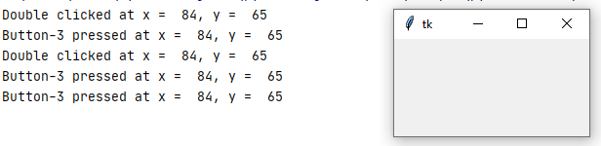
Output

Slide 94
Binding keyboard buttons with the root window(tkinter main window)
# Import all files from
# tkinter and overwrite
# all the tkinter files
# by tkinter.ttk
from tkinter import *
from tkinter.ttk import *
# function to be called when
# keyboard buttons are pressed
def key_press(event):
key=event.char
print(key, ‘is pressed’)
# creates tkinter window or root window
root=Tk()
root.geometry(‘200X100’)
# here we are binding keyboard
# with the main window
root.bind(‘<Key>’,key_press)
mainloop()

Slide 95
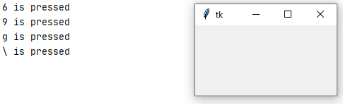
Output

Slide 96
When keyboard buttons are bind with the tkinter window:
When special characters are pressed, only space is got.
When alphabets and numerical characters are pressed, we will get actual values.

Slide 97
Python tkinter canvas
The Canvas is a rectangular area intended for drawing pictures or other complex layouts.
We can place graphics, text, widgets or frames on a Canvas.

Slide 98
Syntax
w = Canvas(master,option-value,….)
Parameters
master − This represents the parent window.
options − Here is the list of most commonly used options for this widget. These options can be used as key-value pairs separated by commas.

Slide 99
Options | Description
bd | Border width in pixels. Default is 2.
bg | Normal background color.
confine | If true (the default), the canvas cannot be scrolled outside of the scroll region.
cursor | Cursor used in the canvas like arrow, circle, dot etc.
height | Size of the canvas in the Y dimension.
highlightcolor | Color shown in the focus highlight.
relief | Relief specifies the type of the border. Some of the values are SUNKEN, RAISED, GROOVE, and RIDGE.

Slide 100
Option | Description
scrollregion | A tuple (w, n, e, s) that defines over how large an area the canvas can be scrolled, where w is the left side, n the top, e the right side, and s the bottom.
width | Size of the canvas in the X dimension.
xscrollincrement | If this option is set to some positive dimension, the canvas can be positioned only on multiples of that distance, and the value will be used for scrolling by scrolling units, such as when the user clicks on the arrows at the ends of a scrollbar.
xscrollcommand | If the canvas is scrollable, this attribute should be the .set() method of the horizontal scrollbar.
yscrollincrement | Works like xscrollincrement, but governs vertical movement.
yscrollcommand | If the canvas is scrollable, this attribute should be the .set() method of the vertical scrollbar.

Slide 101
The Canvas widget can support the following standard items −
arc − Creates an arc item, which can be a chord, a pieslice or a simple arc.
e.g.
coord = 10,50,240,210
arc = canvas.create_arc(coord,start=0,extent=150,fill=“blue”)
image − Creates an image item, which can be an instance of either the BitmapImage or the PhotoImage classes.
e.g.
filename = PhotoImage(file=“sunshine.gif”)
image = canvas.create_image(50,50,anchor=NE,image=filename)

Slide 102
line − Creates a line item.
e.g.
line=canvas.create_line(x0,y0,x1,y1,…..,xn,yn,options)
oval − Creates a circle or an ellipse at the given coordinates. It takes two pairs of coordinates; the top left and bottom right corners of the bounding rectangle for the oval.
e.g.
oval=canvas.create_oval(x0,y0,x1,y1,options)
polygon − Creates a polygon item that must have at least three vertices.
e.g.
oval=canvas.create_polygon(x0,y0,x1,y1,….,xn,yn,options)

Slide 103
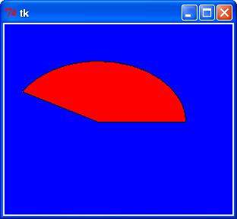
Example
import Tkinter
top=Tkinter.Tk()
C=Tkinter.Canvas(top,bg=“blue”,height=250,width=300)
coord=10,50,240,210
arc=C.create_arc(coord,start=0,extent=150,fill=“red”)
C.pack()
top.mainloop()

Slide 104
Drawing line
A line is a simple geometric primitive.
The “create_line” method creates a line item on the Canvas.

Slide 105
Example
from tkinter import Tk, Canvas, Frame, BOTH
class Example(Frame):
def __init__(self):
super().__init__()
self.initUI()
def initUI(self):
self.master.title(“Lines”)
self.pack(fill=BOTH,expand=1)
canvas=Canvas(self)
canvas.create_line(15,25,200,25)
canvas.create_line(300,35,300,200,dash=(4,2))
canvas.create_line(55,85,155,85,105,180,55,85)
canvas.pack(fill=BOTH,expand=1)
def main():
root=Tk()
ex=Example()
root.geometry(“400X250+300+300”)
root.mainloop()
if __name__==‘__main__’:
main()

Slide 106
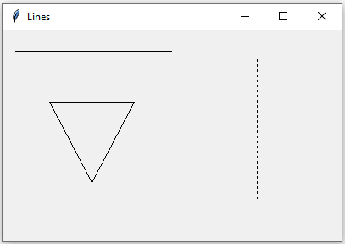
Output

Slide 107
Drawing oval
An oval is any curve that resembles an ellipse.
We can create an oval on a canvas “c”with the following method:
id = C.create_oval(x0,y0,x1,y1,option,….)
This method returns the object ID of the new oval object on the canvas C.

Slide 108
Example
The following script draws a circle around the point (75,75) with the radius 25.
from tkinter import *
canvas_width=190
canvas_height =150
master=Tk()
w=Canvas(master,width=canvas_width,height=canvas_height)
w.pack()
w.create_oval(50,50,100,100)
mainloop()

Slide 109
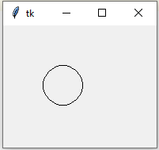
Output

Slide 110
Drawing Rectangle
from tkinter import *
master=Tk()
w=Canvas(master,width=250,height=200)
w.create_rectangle(0,0,100,100,fill=“blue”,outline=‘blue’)
w.create_rectangle(50,50,100,100,fill=“red”,outline=‘blue’)
w.pack()
master.mainloop()

Slide 111
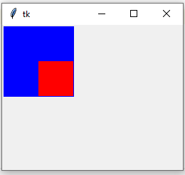
Output

Slide 112
Drawing arc
from tkinter import *
import tkinter
master=tkinter.Tk()
def create_arc1():
canvas=tkinter.Canvas(master,width=250,height=300)
canvas.pack()
x1_value=input(“Please enter x1 arc value:”)
x1=int(x1_value)
y1_value=input(“Please enter y1 arc value:”)
y1=int(y1_value)
x2_value=input(“Please enter x2 arc value:”)
x2=int(x2_value)
y2_value=input(“Please enter y2 arc value:”)
y2=int(y2_value)
canvas.create_arc(x1,y1,x2,y2)
button=tkinter.Button(master,text=“Create Arc”,command=create_arc1).pack()
master.mainloop()

Slide 113


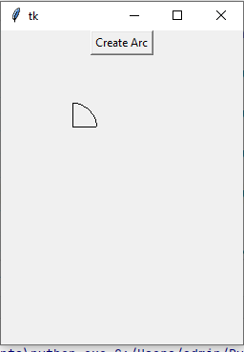
Output

